Slide 1
Trello Scrum Board Details

Slide 2
Topics
Trello Scrum Board List
Product Backlog User Stories Sample
User Story Details

Slide 3
Trello Scrum Board Template
Get the template from:
https://tinyurl.com/srumboardtemplate
Also get this Chrome extension so that you can super charge your workflow by adding Story Points to Product Backlog Items.
https://chrome.google.com/webstore/detail/scrum-for-trello/jdbcdblgjdpmfninkoogcfpnkjmndgje
(N.B. You will need to copy the link to the browser)

Slide 4
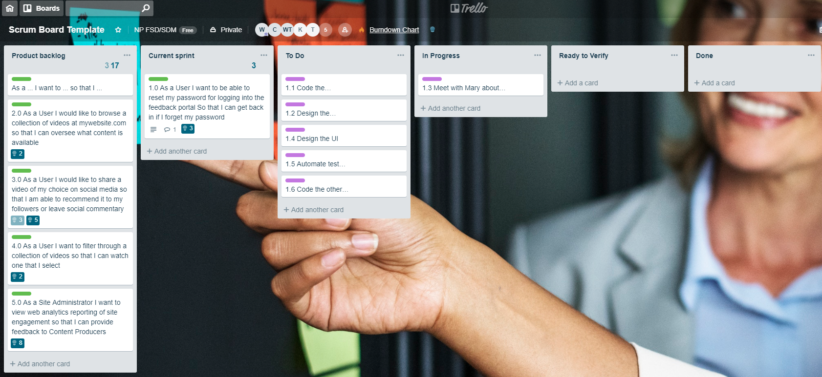
Trello Scrum Board Lists
Five List Title:
Product Backlog, Current Sprint, In Progress, Ready to Verify and Done.

Slide 5
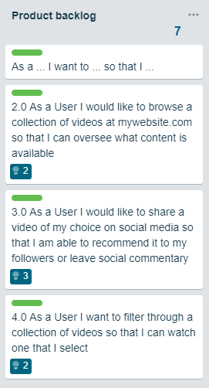
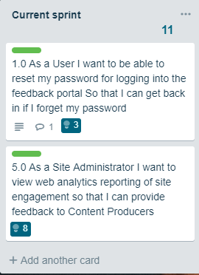
Product Backlog User Stories Sample
Total Estimated Points
Guide to write the User Story
We shall use this for details
Estimated Points

Slide 6
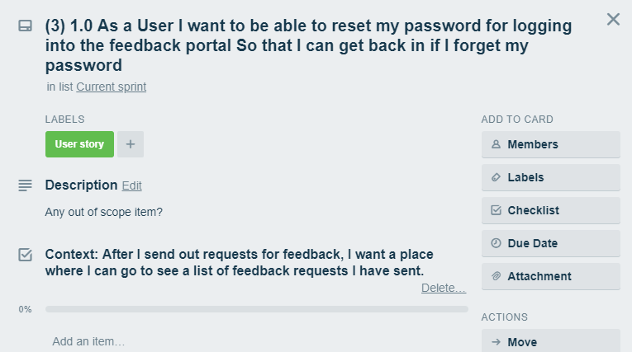
User Story Details to Set Up (1)
Main User Story
Any other details
Details on how it apply

Slide 7
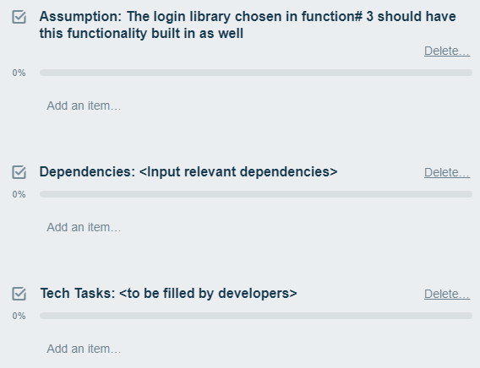
User Story Details to Set Up (2)
Assumptions:
Project Assumptions are events or circumstances that are expected to occur
Dependencies:
Relationships of the preceding tasks to the succeeding tasks. Tasks may have multiple preceding tasks and multiple succeeding tasks.
Technical tasks to be established for this story

Slide 8
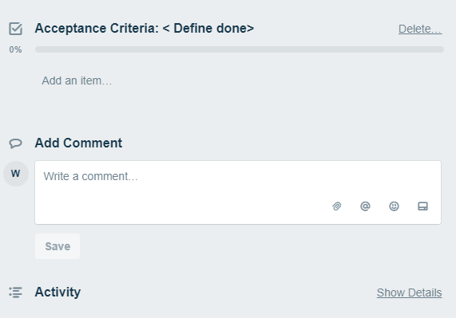
User Story Details to Set Up (3)
Acceptance Criteria:
Conditions which a software application should satisfy to be accepted by a user or customer
Activity:
Any special particular activity to be noted

